Slide 1

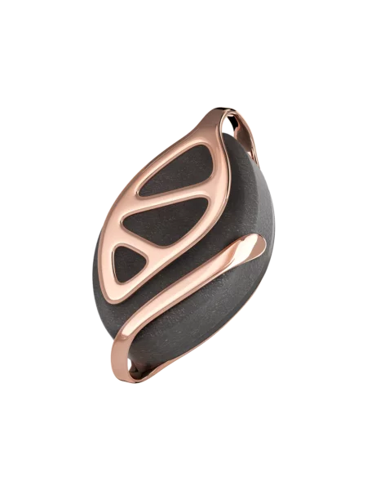
Bellabeat Urban Leaf
Case Study: How Can a Wellness Technology Company Play It Smart?
Nikita Voth
10.08.2021

Slide 2
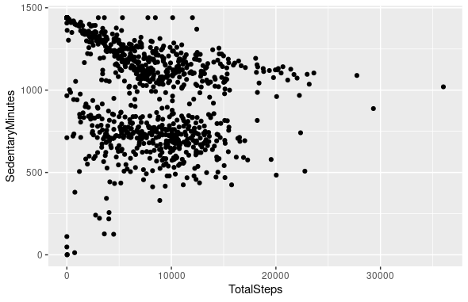
Comparison between activity and non-activity

Slide 3

The graph shows the relationship between participants working out and their sitting time
It shows that people spend less time sitting, when the effort to do activities is high
On the contrary: People spend more time sitting, when the number of activities goes down
The conclusion is, that the more time people spend on activities, the less time they spend sitting

Slide 4
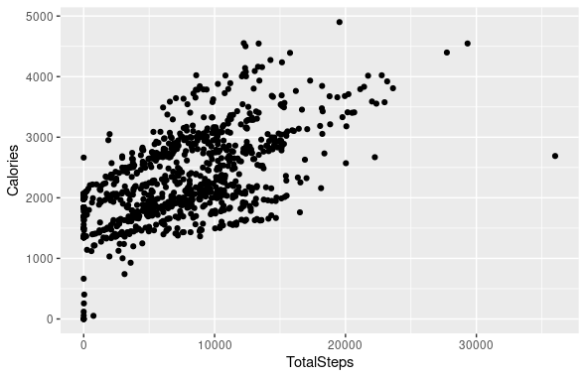

Activity and calories

Slide 5

This graph shows clearly the correlation between Calories and the time people spend on activities
You can see how the calories change whenever people use to do more activities
At the beginning the graph shows the people who lost the least
The conclusion is that the more people exercise, the more calories they loose

Slide 6
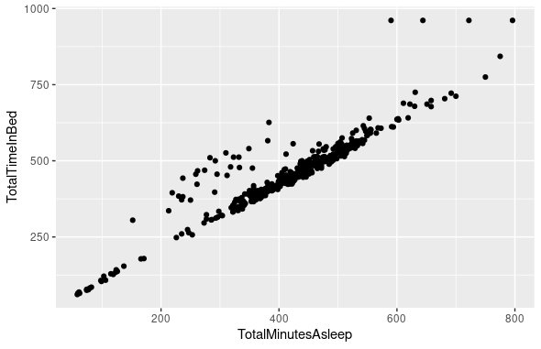
Time duration spent in bed

Slide 7
This scatter plot is almost constantly linear
There are some dots which deviate
Most of the people spend a little bit more time laying in bed after waking up
Some lay in bed after being awake longer than the majority
The top right corner of the graph shows a minority of people who spend much more time laying in bed after waking up

Slide 8
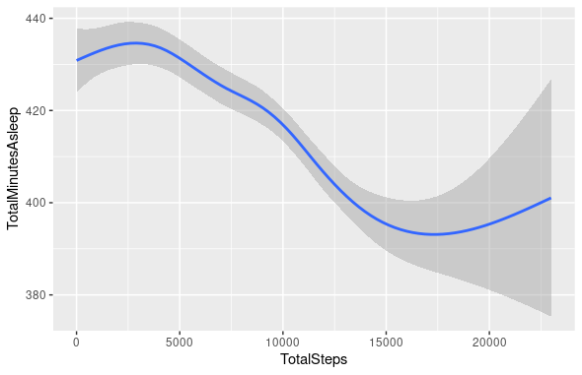
Relationship between sleeping time and activity

Slide 9
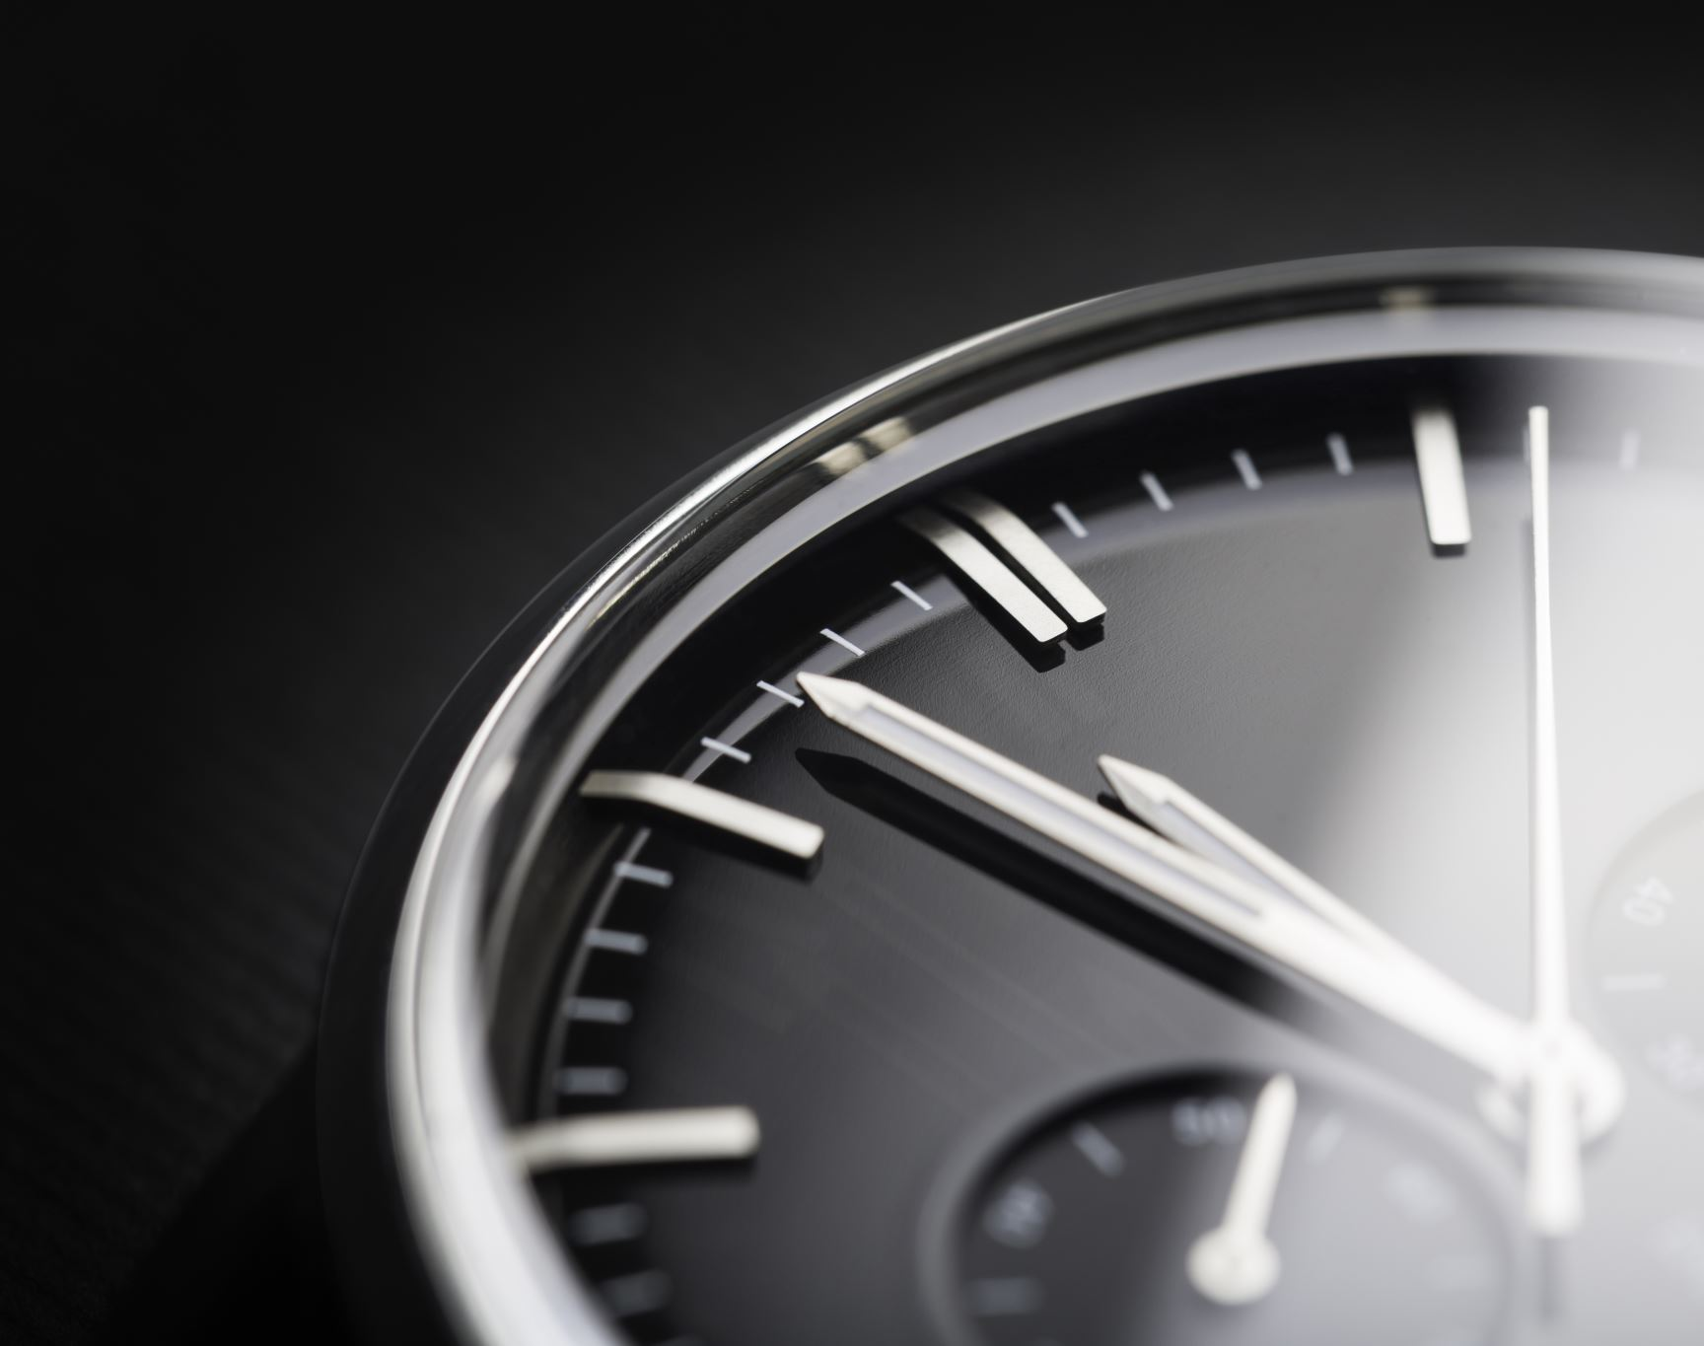
This graph shows how much people sleep and the result of their activity time
You can see how the line goes down whenever people use to exercise more.
Therefore, the sleep duration goes down, the time and amount of activity goes up
At the end of the graph, you can see how the line goes up again.
Conclusion: The more time people do activities, the less time they sleep

Slide 10
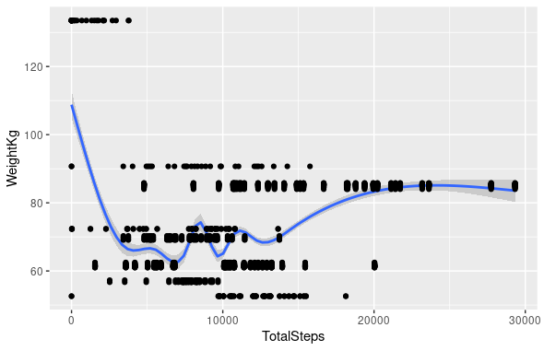
Relationship between activity and weight

Slide 11
This graph is showing how much people weight and their activity
The line starts from 110 and goes down significantly
People who start doing activities losing weight
There is a constant number of people doing a lot activities and are overweight
In the top left there are a lot of people who do not exercise and are obese

Slide 12
Ideas and solutions for our product
A system which values your activity time and tells you when to implement breaks and for how long.
By tracking the time, the device can produce suggestions how to use the time better and how to improve time management
Having a system implemented, which can differentiate between productive and unproductive time
Being able to track records of being asleep, productive time and unproductive time
We can improve the system, so it is able to track the calories and the weight. Therefore, giving further suggestions how to keep it up
Let the system being able to share data with others near you, who share the same goals as you

Slide 13
Thank you for your time and attention
For my data cleaning, preparing, processing and analyzing, I used Spreadsheets(Excel), R programming language, and PowerPoint
RStudio Team (2021). RStudio: Integrated Development Environment for R. RStudio, PBC, Boston, MA URL http://www.rstudio.com/.
Data source: FitBit Fitness Tracker Data | Kaggle
Data was made available through “Mobius”
df

